Slide 1






Impact
Medication Abortion in the First Trimester
Approach
Medications
Follow-up
Side Effects
Take our quiz to test your knowledge!
Cases
Copyright: The Daily News, The Washington Post, The New York Times
Notes:
When Roe v. Wade was overturned June 24, 2022, hundreds of thousands of women* (in this talk the term refers to people with uteruses) lost access to vital reproductive healthcare. This led healthcare workers predominantly in the fields of OB-Gyn and family medicine to scramble to find ways to prescribe medication and procedural abortion to their patients while also protecting their medical licenses. Lack of access to abortion disproportionately impacts people of color and lower socioeconomic status.
As internal medicine providers, adults with uteruses account for 50% of the patients we treat. By learning how to prescribe just two medications, we can respond to the urgent need to help patients retain autonomy over their bodies and join the fight for reproductive justice alongside our colleagues. Please keep in mind the information on this topic is continually changing so for updated information consult the Guttmacher Institute.
In this talk, we will be discussing the medications used for abortion, side effects, complications, and indications for surgical referral. Allow space for any of your learners, who may be uncomfortable with these topics, to excuse themselves if needed.
Resources:
McCann, Allison, et al. “Tracking the States Where Abortion Is Now Banned.” The New York Times, The New York Times, 24 May 2022, www.nytimes.com/interactive/2022/us/abortion-laws-roe-v-wade.html.
Bazelon, Emily. “Risking Everything to Offer Abortions across State Lines.” The New York Times, The New York Times, 4 Oct. 2022, www.nytimes.com/2022/10/04/magazine/abortion-interstate-travel-post-roe.html.

Slide 2
Impact
Medication Abortion in the First Trimester
Indications
Medications
How many…
…patients (per year) no longer have access to abortion?
Follow-up
…patients (per year) no longer have access to abortion?
250k
Side Effects
Cases
…states have a mandatory waiting period between counseling and abortion?
…states have a mandatory waiting period between counseling and abortion?
27
…gestational weeks is medication abortion safe and effective for?
…gestational weeks is medication abortion safe and effective for?
11
Copyright: The Daily News, The Washington Post, The New York Times
Notes:
When Roe v Wade was overturned June 24, 2022, hundreds of thousands of women* (in this talk the term refers to people with uteruses) lost access to vital reproductive healthcare. This led healthcare workers predominantly in the fields of OB-gyn and family medicine to scramble to find ways to prescribe medication and procedural abortion to their patients while also protecting their medical licenses. Abortion is a safe and common medical procedure. As internal medicine providers, adults with uteruses account for 50% of the patients we treat. By learning how to prescribe just two medications, we can respond to the urgent need to help patients retain autonomy over their bodies and join the fight for reproductive justice alongside our colleagues.
Resources:
McCann, Allison, et al. “Tracking the States Where Abortion Is Now Banned.” The New York Times, The New York Times, 24 May 2022, www.nytimes.com/interactive/2022/us/abortion-laws-roe-v-wade.html.
Bazelon, Emily. “Risking Everything to Offer Abortions across State Lines.” The New York Times, The New York Times, 4 Oct. 2022, www.nytimes.com/2022/10/04/magazine/abortion-interstate-travel-post-roe.html.

Slide 3




Impact
Stepwise Approach to Medication Abortion
Approach
Confirm pregnancy and gestational age
Considered up to 77 d (11 wk) of gestation
First day of LMP
± Ultrasound
Unknown LMP (or during hormonal contraception)
Risk for ectopic pregnancy
Confirm pregnancy and gestational age
Medications
Follow-up
Choose a medication regimen
Side Effects
Choose a medication regimen
Mifepristone + misoprostol (95-98% effective)
Misoprostol alone (76-88% effective)
Cases
Bleeding disorders, anticoagulation
Ectopic pregnancy
IUD
Hgb <9.5 g/dL (relative)
Medication Specific
Mifepristone: steroids, adrenal failure
Misoprostol: porphyria
Assess for medical contraindications
Assess for medical contraindications
Benefits, risks, alternatives
Provider agreement
Medication information handout
After-care instructions
Obtain consent
Obtain consent
Notes:
Medication abortion can safely be used up to 11 weeks, although use beyond 10 weeks is considered off label.
Step 1: Confirm pregnancy with urine hcg and estimated gestational age (EGA) using the first day of the last menstrual period (LMP).
If LMP is unknown, ultrasound may aid in confirming gestational age though it is not necessary if the patient is certain of their LMP and they were not using hormonal contraception.
Ultrasound is also helpful if ectopic pregnancy is suspected in patients with prior ectopic pregnancy, tubal surgery or pathology, current IUD use, and use of in-vitro fertilization for the current pregnancy.
Step 2: Choose the appropriate medication regimen. The combination of mifepristone and misoprostol is most effective (95-99% effective) and is the recommended treatment for medical abortion. For patients with relative or absolute contraindications to mifepristone or in practice settings where mifepristone is not available, misoprostol can be used alone for medical abortion. However, misoprostol alone is only 76-88% effective).
Step 3: Assess for medical contraindications.
While anemia (Hgb <9.5g/dL) is not a strict contraindication, the safety of abortion in this patient population is unknown. They may pursue an abortion if they are willing to have closer follow up. Transfusion rate for medication abortion is less than 0.1% so unless there is a concern for anemia, testing Hgb is not necessary.
Absolute contraindications to medication abortion include ectopic pregnancy, presence of an IUD, known coagulopathy, and anticoagulant therapy.
Certain medical conditions such as heart failure, cancer, and uncontrolled lupus may increase the risk of morbidity and mortality due to pregnancy. If a patient wishes to proceed with pregnancy in the setting of a high-risk condition, offer referral to maternal fetal medicine (MFM).
Mifepristone specific: Patients on corticosteroids or with history of adrenal insufficiency should not take mifepristone as it is a synthetic steroid. At higher doses it blocks the effect of cortisol at the glucocorticoid receptor, potentially blocking the effect of exogenous corticosteroids and precipitating adrenal insufficiency. While experienced clinicians may still prescribe mifepristone for these patients, they would require close monitoring for development of hypokalemia, hypotension, or other signs of adrenal insufficiency so would likely be safer receiving surgical abortion instead.
Misoprostol specific: Patients with porphyria are discouraged from taking misoprostol. Patients should also not take magnesium-containing supplements simultaneously with misoprostol due to risk of worsened GI side effects.
Step 4: Obtain informed consent and review how to refer a patient for uterine aspiration or blood transfusion if needed. Ensure prescriber and patient agreements are signed and include after-care instructions in your patient’s visit summary (see supplemental materials for these). Patients should be aware that...
Taking medication abortion pills does not adversely affect future fertility or pregnancy outcomes.
Rh testing is no longer recommended for abortion under 12 weeks, even for those who are known to be Rh neg as there is minimal risk of enough maternal-fetal blood mixing to induce alloimmunization.
Alternatives to medication abortion include surgical abortion, carrying pregnancy to term, and adoption after birth.
Over 90% of patients are confident in their choice and do not regret it. Once taken, there is no reversal agent. Due to the teratogenicity of misoprostol, patients with incomplete abortions should be referred for uterine aspiration.
Some states require 24+ hours of waiting after counseling which can delay care and make it more difficult to access abortion due to need for multiple days off from work, childcare, and other hurdles. Case 2 contains a QR code where learners can access laws pertaining to mandatory waiting periods by state which is updated frequently.

Slide 4
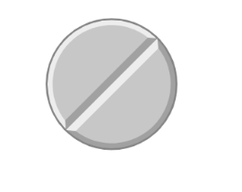
Impact
Medications for Abortion
Approach
Misoprostol 800 mcg x 1 buccal or vaginal
6 h after 1st dose
Recommended if 9-11 wks gestation
Mifepristone available
Medications
Mifepristone 200 mg PO x 1
Follow-up
Side Effects
0 hours
24-48 hours
30-56 hours
Cases
Misoprostol 800 mcg x 1
Buccal – 2 x 200 mcg tablets on each buccal surface
Vaginal – can be given as early as 6h after mifepristone
Follow-up
0 hours
Mifepristone not available
Misoprostol 800 mcg PO q3h x 3 doses
Notes:
Mifepristone available: In patients who are able to take mifepristone and in practice settings where this is available, the conbination of mifepristone and misoprostol is recommended. Mifepristone is a progesterone receptor modulator that promotes placental separation, cervical dilation, and sensitization of the myometrium to prostaglandins such as misoprostol. Misoprostol is a prostaglandin E1 analogue that causes cervical softening and uterine contractions.
An oral dose of mifepristone is taken, followed by misoprostol buccally or vaginally 24-48 hours later.
It is very important that the patient waits at least 24 hours after mifepristone dose for optimal efficacy. If the patient vomits less than 30 minutes after the dose of mifepristone, another must be taken.
Between 9 and 11 weeks of gestation, a second dose of misoprostol must be taken 3-6 hours after the first dose.
The combination of mifepristone and misoprostol is 95-98% effective at inducing abortion up to 11 weeks, whereas efficacy for misoprostol alone ranges from 78-93%.
Mifepristone not available: If the patient has a contraindication to mifepristone, they may take misoprostol monotherapy with repeated dosing every 3 hours for up to 3 doses. There are less GI side effects when misoprostol is taken vaginally.

Slide 5
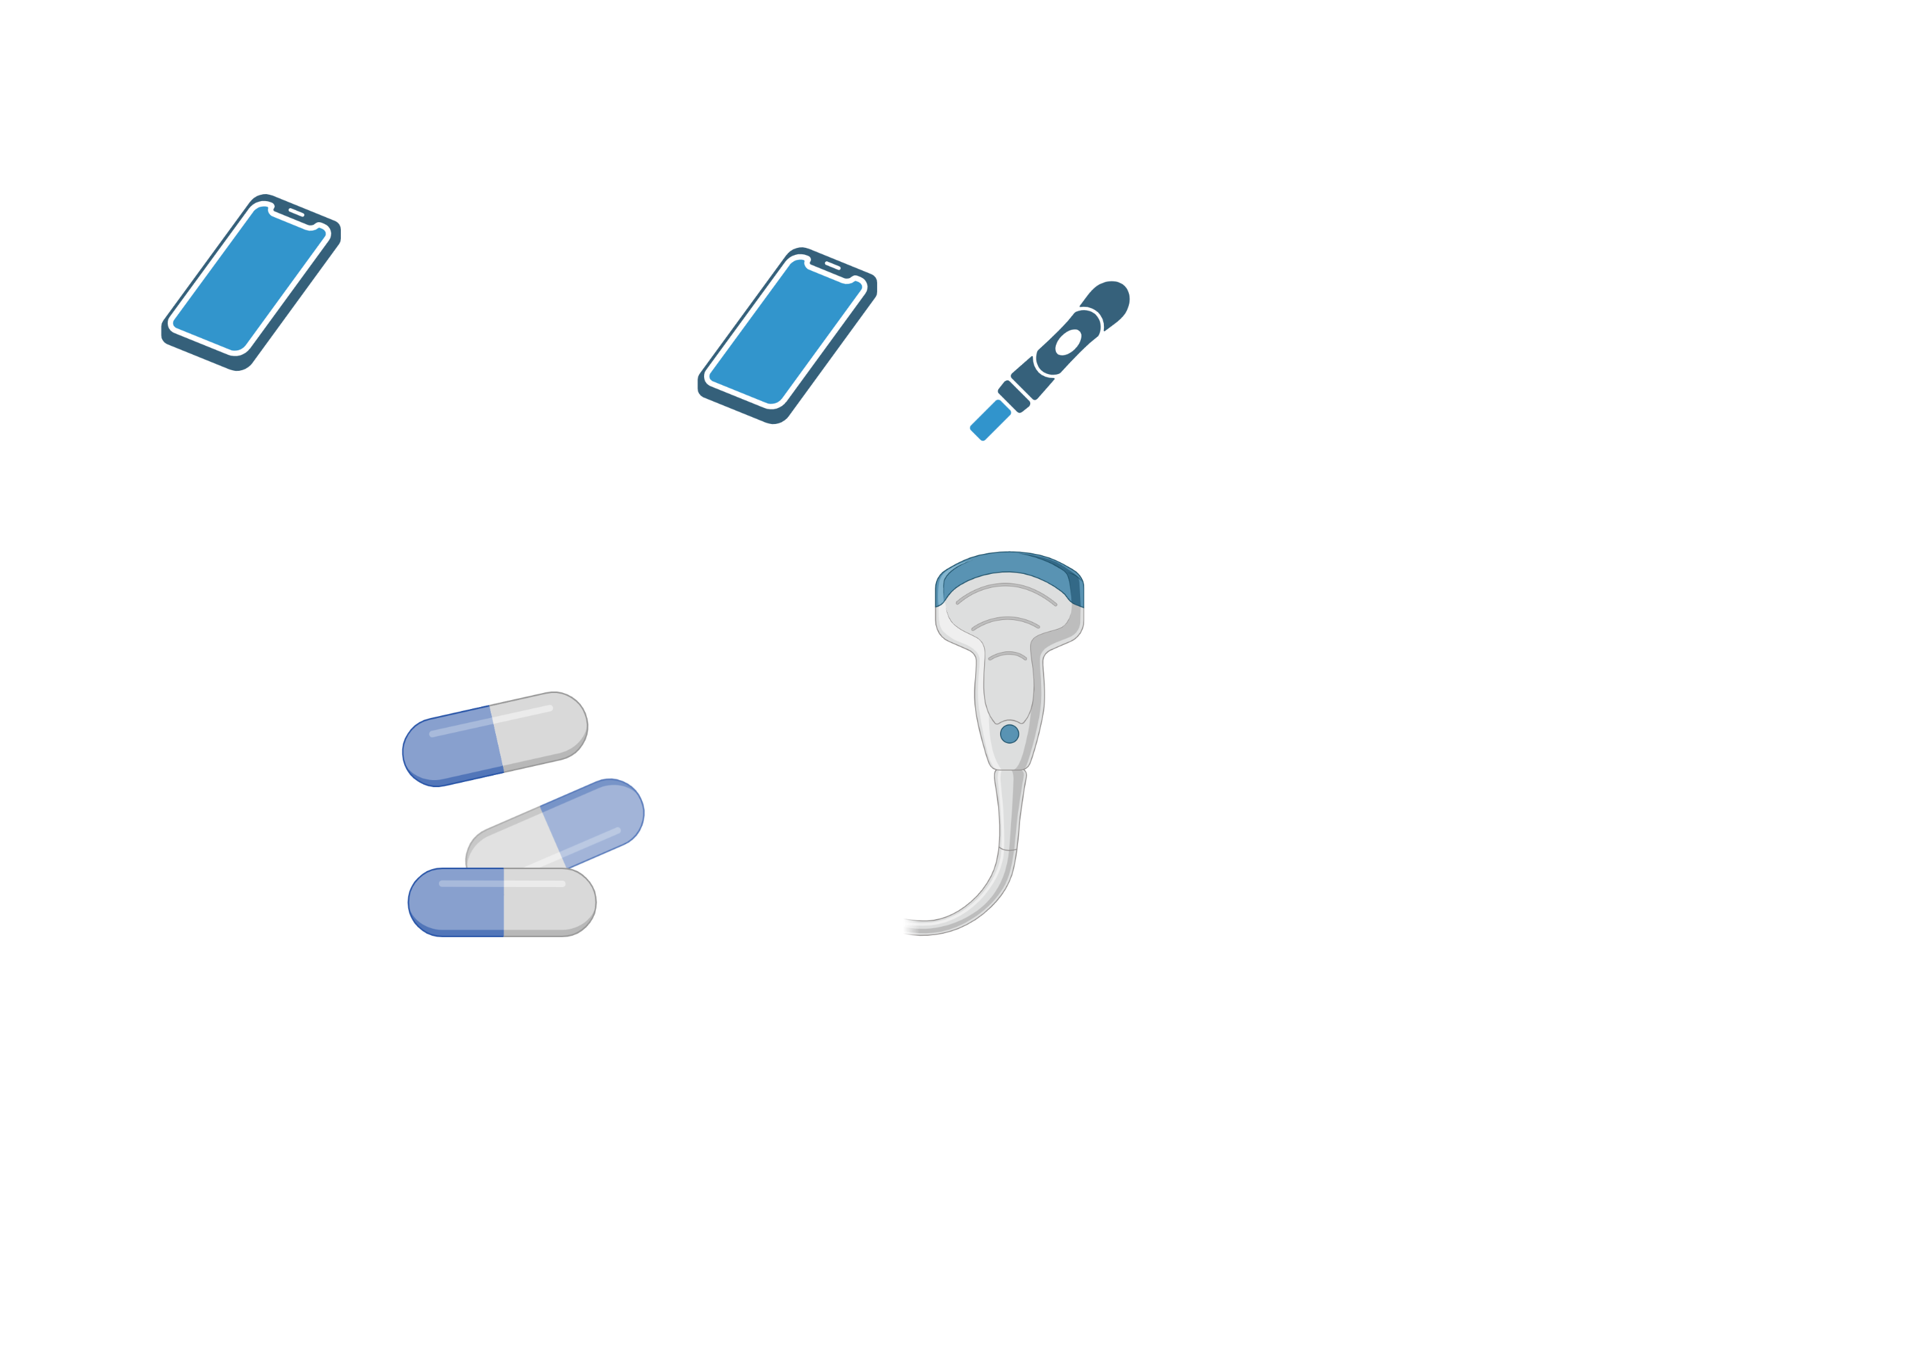
Impact
Abortion Follow-up
Approach
Medications
Mifepristone + Misoprostol
Follow-up (optional)
Urine pregnancy test
At home or in clinic
Not before 4 wks post-abortion
Follow-up
All patients must be offered phone or in-person follow-up within 14 d.
Side Effects
0 hours
Cases
1-2 weeks
4 weeks
1-2 wks
4 wks
Ongoing symptoms of pregnancy?
No passage of clot/POC?
Ongoing bleeding?
Ongoing symptoms of pregnancy?
No passage of clot/POC?
Ongoing bleeding?
Positive pregnancy?
Positive pregnancy?
0 hours
Misoprostol alone
Pelvic US (optional)
Refer to Gynecology
Notes:
Ask your learners what follow-up may be needed at “1-2 weeks” and at “4 weeks” and click to reveal the answer.
According to 2020 practice guidelines from the National Abortion Federation, patients should be offered follow up within 14 days though they may also opt for self-assessment. Assess for ongoing pregnancy symptoms such as breast tenderness, fatigue, and morning sickness 1-2 weeks after the misoprostol dose. Patients may also consider lab or home urine pregnancy testing at 4-6 weeks, but not prior to 4 weeks.
If the patient continues to have symptoms of pregnancy and is still <11 weeks EGA, they may take another dose of vaginal misoprostol prior to proceeding to aspiration. Alternatively, a pelvic ultrasound to confirm an empty gestational sac can be performed at 1-2 weeks after taking the medications.
It is important to emphasize that absence of a gestational sac confirms success of the medication abortion, as some radiologists may be overly cautious when evaluating for retained products of conception. While there is no endometrial thickness cutoff, it would be appropriate to have a patient follow-up with a family planning clinic if there are concerns, rather than moving directly to repeat intervention.

Slide 6
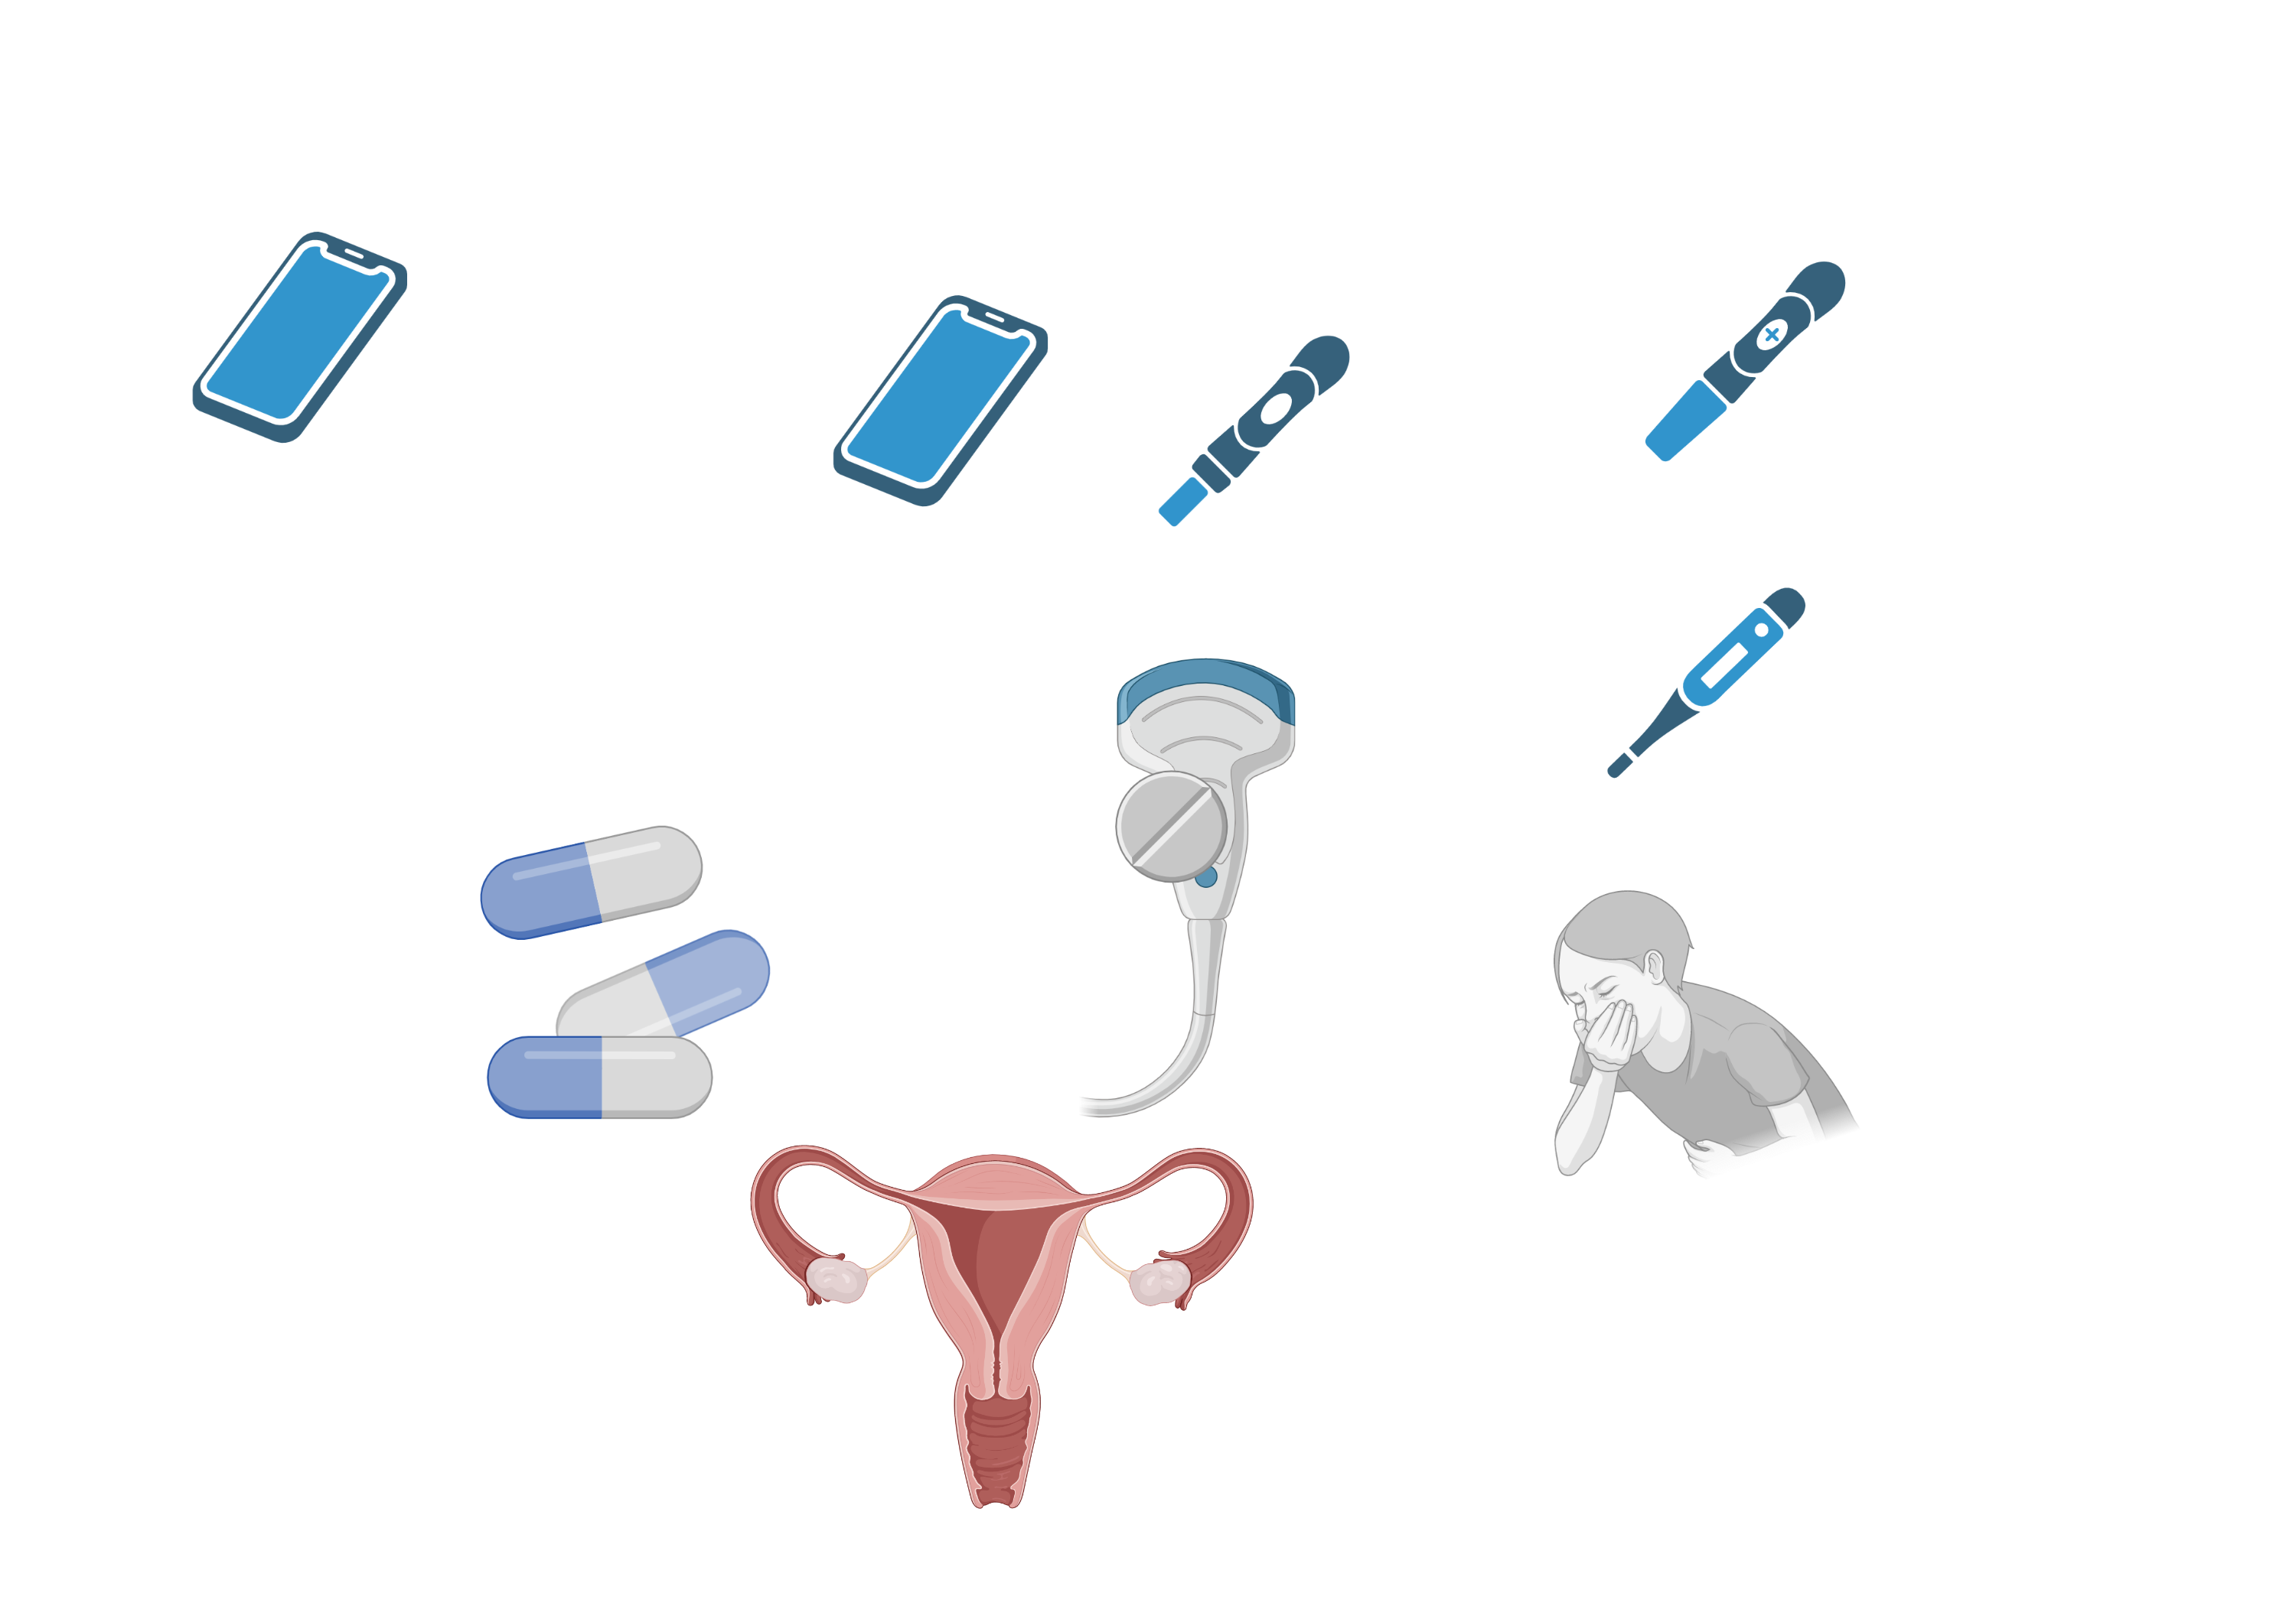
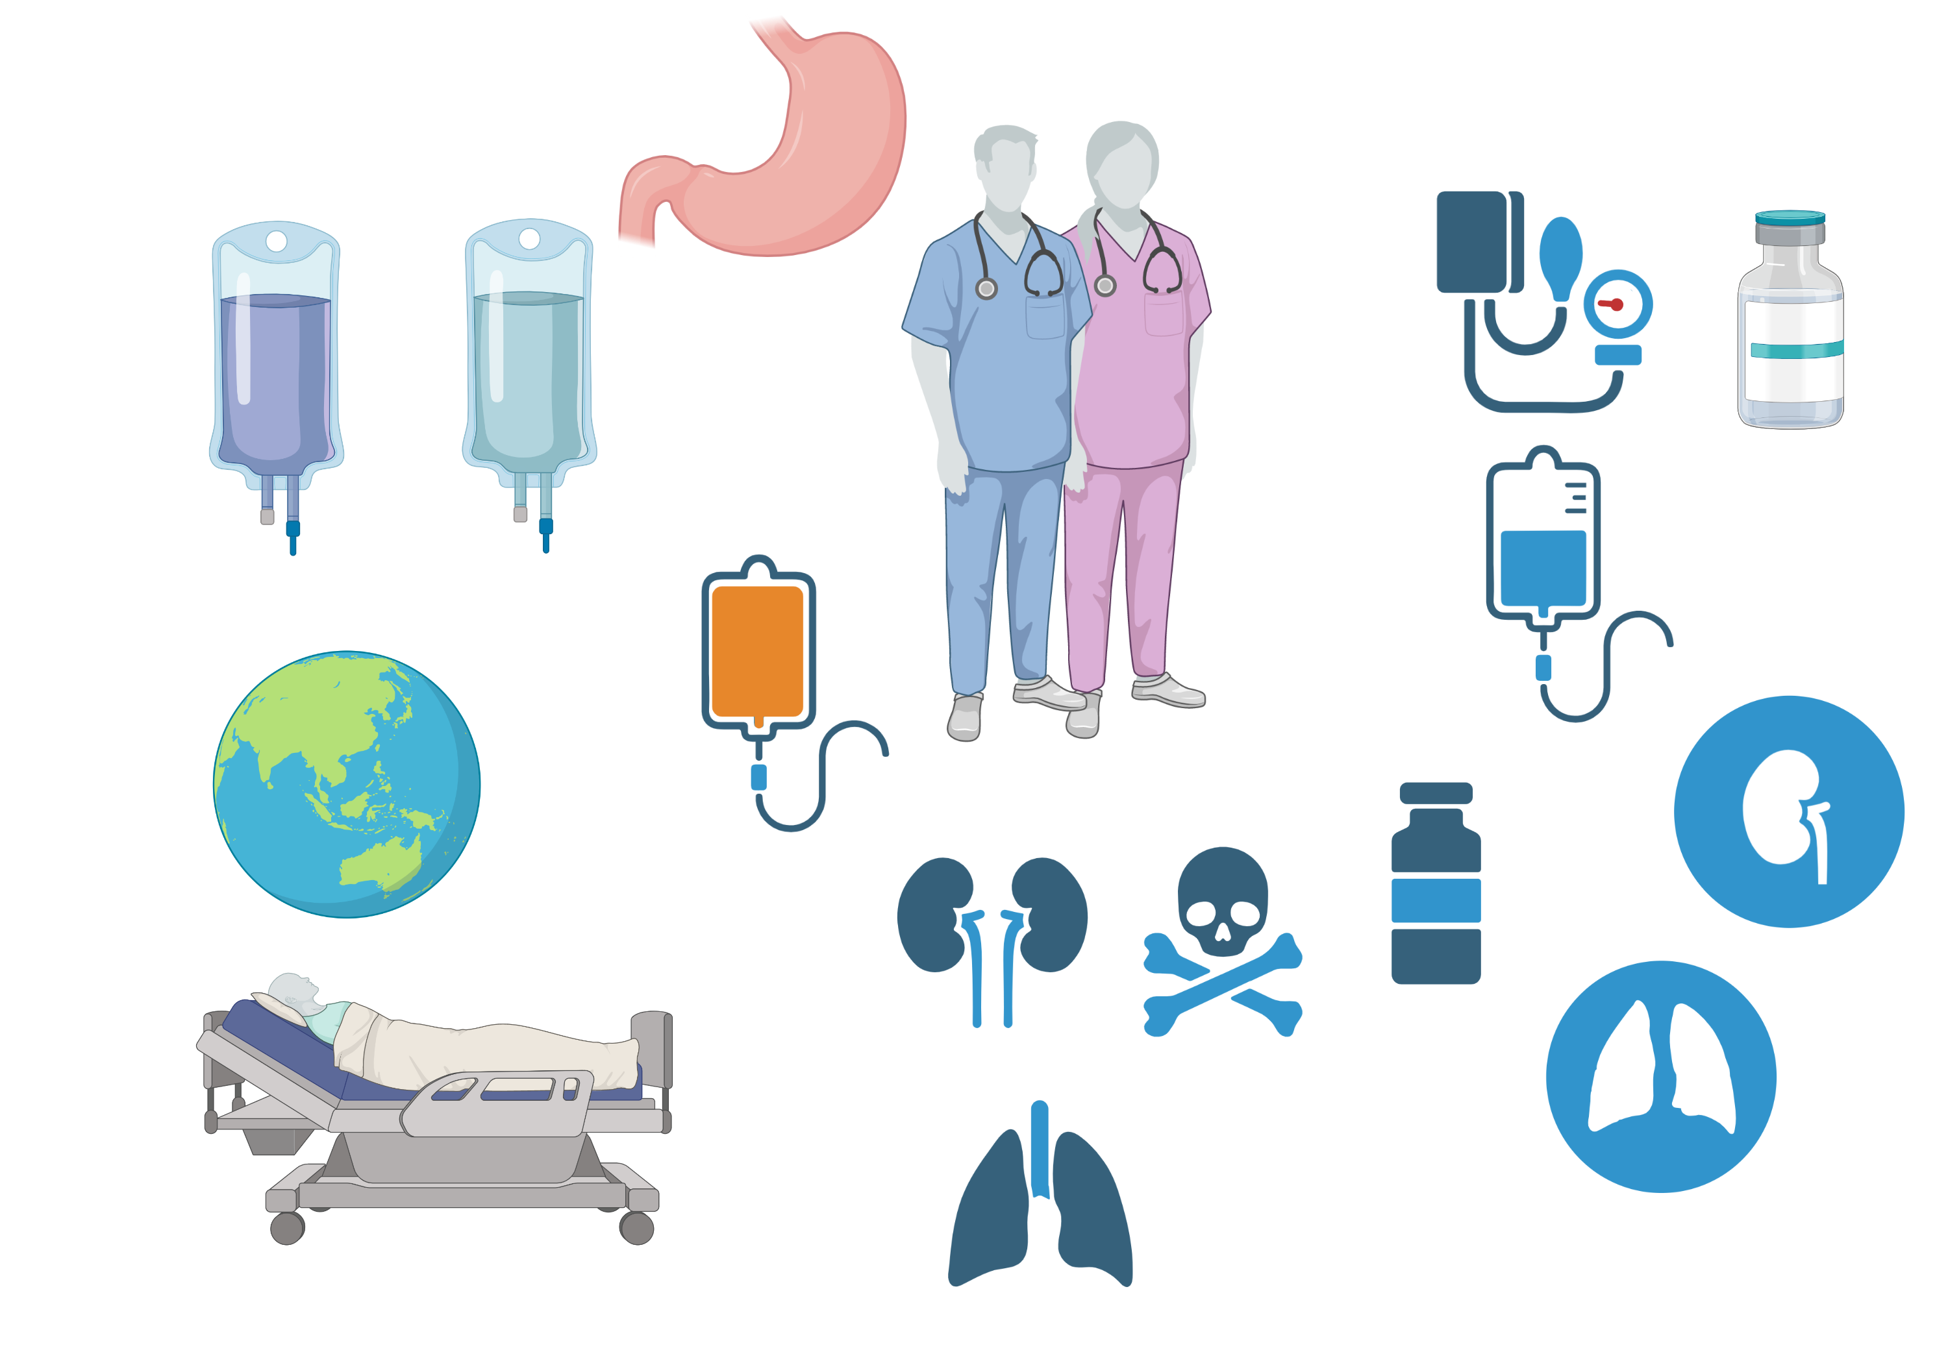
Impact
Side Effects and Complications
Approach
Expected Side Effects
Expected Side Effects
Complications
Complications
Medications
Incomplete abortion (<5%)
Risk ↑ >8 wk of gestation
Higher risk of failure with misoprostol alone
Refer for surgical abortion
Prolonged/heavy bleeding (1%)
Seek emergency care if >2 pads/h x 2h or symptoms of anemia
Requiring transfusions (<0.1%)
Follow-up
Cramping/Bleeding
Heavier/more painful than period, starting 2-4h after misoprostol, lasting ~1h
Side Effects
Cramping/ bleeding​
Incomplete/failed abortion
Prolonged/heavy bleeding​
Cases
Intrauterine infection (1.2%)
Seek emergency care if…
Prolonged pelvic pain
Abnormal vaginal discharge
Fevers/chills >24h
Fevers/ malaise
Fevers, chills and flushing (32-69%)
Constitutional symptoms
GI symptoms (30-40%)
Nausea, vomiting, and diarrhea
Intrauterine infection
Fevers/ malaise
GI symptoms
Notes:
Ask your learners what expected side effects and complications you may see after a medical abortion. Click on each side effect/complication for more information.
The expected effects of medication abortion include:
Severe cramping and bleeding: Bleeding is heavier than menses. This often begins 2.5-4 hours after the misoprostol dose, and lasts about an hour, though it can last up to 24 hours.
GI side effects: include nausea (43-46%) vomiting (23-40%), diarrhea (23-35%)
Fever/flushing/chills (32-69%). Patients may also experience constitutional symptoms such as malais

Slide 7

Impact
Case 1a
Case 1b
Case 1c
A 30-year-old transgender man (they/them) with a uterus presents for a missed period. Their LMP was 6 weeks ago. They are not on hormonal contraception and are worried about pregnancy.
They decide they would like to proceed with medication abortion. They have no medical problems and are not on any medications.
You prescribe mifepristone + misoprostol x 1 dose.
Approach
How do you counsel them on side effects?
Medications
Do they have any contraindications to medical abortion?
Severe cramping and bleeding that is heavier than menses, typically occurs 2.5-4 hours after misoprostol dose and lasts 1-24 hours though rarely 24h
Nausea, vomiting, diarrhea
Fever for <24h, hot flushes, chills.
Follow-up
What is your next step in evaluation?
Confirm pregnancy with Urine hcg
No. Contraindications include:
Any medical abortion: ectopic pregnancy or IUD in place
Mifepristone: corticosteroids or known adrenal failure
Misoprostol: porphyria
Side Effects
…Urine pregnancy test is positive.
Cases
What is the gestational age?
EGA is 6 weeks.
1
What history might lead you to suspect ectopic pregnancy?
…They call back with heavy bleeding for the past 5 hours, soaking through 4 pads an hour for the past 2 hours. They deny light-headedness or dyspnea.
How do you counsel on patient’s choice regarding their pregnancy?
2
High risk: prior ectopic pregnancy, tubal surgery or pathology, IUD use, and use of in-vitro fertilization for the current pregnancy
Review options including carrying pregnancy, adoption and terminating pregnancy. Provide additional resources.
What is your next step in management?
What resources or restrictions are in effect in your state?
This is heavier than expected bleeding (>2 pads/1h x 2 h). They should be evaluated in the ED. This is an extremely rare complication in <1%.
Take a moment to familiarize yourself with waiting periods and restrictions from the Guttmacher Institute.

Slide 8
Impact
Case 2a
Case 2b
Case 2c
A 21-year-old woman with history of SLE on prednisone 5 mg daily seeks contraception counseling. She is interested in having children in the distant future but wonders how her condition will affect pregnancy.
Urine HCG is positive. She wishes to have a medication abortion.
Approach
How will you counsel her on the risk of incomplete abortion?
Medications
What is the next step in evaluation?
She has higher risk of incomplete abortion.
Misoprostol alone is associated with higher risk of incomplete abortion (78-93% success with misoprostol-only abortions compared with 93-95% with the combination regimen) 2019 meta-analysis.
Risk of incomplete abortion also increases as the EGA approaches 10 weeks.
Because she is unclear on her LMP, ultrasound is needed to confirm gestational age <11 weeks
Follow-up
According to the CDC, what medical conditions are associated with increased risk for adverse health events as a result of pregnancy?
Side Effects
…Transabdominal ultrasound demonstrates EGA of 9 weeks.
SLE
Insulin-dependent diabetes with complications
Uncontrolled HTN
Heart disease (valvular, ischemic, peripartum)
Bariatric surgery within the past 2 years
Solid organ transplant within the past 2 years (see CDC website for full list)
Cases
What medication(s) do you prescribe?
Misoprostol 800 mcg x 3 due to EGA > 9 weeks. Mifepristone is contraindicated due to her corticosteroid use.
1
2
…The patient anticipates undergoing future pregnancy.
…During a telephone visit 1 week later, she continues to have morning sickness and breast tenderness.
Would you recommend Rh testing prior to abortion?
What are the next steps in management?
…She is interested in the copper IUD. Her LMP was 9-11 weeks ago but she often has irregular periods.
No. Rh testing is no longer recommended for abortion under 12 weeks, even for those who are known to be Rh neg as there is minimal risk of enough maternal-fetal blood mixing to induce alloimmunization.
If <11 weeks EGA, patients may take an extra dose of misoprostol 1 week after the first for ongoing symptoms of pregnancy. Alternatively, she may be referred now for surgical abortion.
What is the next step in evaluation?
Urine pregnancy test

Slide 9
Access & Regulatory Update (2023–2026) — clinical regimen unchanged
• Jan 2023 — FDA modified the mifepristone REMS: in-person dispensing requirement removed; certified retail and mail-order pharmacies may dispense with a prescription from a certified prescriber (CVS/Walgreens certified, Mar 2024).
• Jun 13, 2024 — FDA v. Alliance for Hippocratic Medicine: U.S. Supreme Court (9–0) dismissed the challenge for lack of standing; FDA approval and the 2016/2021–23 REMS changes stand.
• May 2026 — Louisiana v. FDA: Fifth Circuit (May 1, 2026) ordered a return to in-person-only dispensing; the Supreme Court stayed that order May 14, 2026 (Danco Labs v. Louisiana), preserving telehealth prescribing + mail/pharmacy dispensing while litigation continues.
• What this means for this talk: the clinical teaching (regimens, contraindications, follow-up) is unchanged. The ACCESS landscape remains in flux — verify current federal status and your state law (Guttmacher Institute) before prescribing.
– Sources: FDA REMS (Jan 2023); SCOTUS 23-235 (Jun 2024); SCOTUS 25A1207 (May 2026); Guttmacher Institute state-policy tracker.

Slide 10
Take-Home Points
• Before prescribing: confirm pregnancy (urine hCG), estimate gestational age from LMP (± ultrasound if LMP unknown, hormonal contraception, or ectopic risk), screen contraindications, and check your state law / mandatory waiting periods.
• Medication abortion is used up to 11 wk (77 d); beyond 10 wk is off-label. Mifepristone 200 mg PO, then misoprostol 800 mcg buccal/vaginal 24–48 h later (95–98% effective); add a 2nd misoprostol dose if 9–11 wk.
• If mifepristone is unavailable or contraindicated: misoprostol 800 mcg q3h × 3 doses (less effective, ~76–93%).
• Contraindications: ectopic pregnancy, IUD in place, coagulopathy/anticoagulation (any regimen); chronic corticosteroids/adrenal failure (mifepristone); porphyria (misoprostol).
• Expected: cramping + bleeding heavier than menses (~2.5–4 h after misoprostol), GI symptoms, fever/chills. Seek care: >2 pads/h × 2 h, prolonged pelvic pain, abnormal discharge, fever >24 h.
• Offer follow-up within 14 d; urine pregnancy test no earlier than 4 wk. Rh testing NOT recommended <12 wk. No effect on future fertility.

Slide 11
Attribution & Changelog
• Original: "Medical Abortion in the First Trimester," TeachIM.org, June 2023 — deQuillfeldt, Asare, Cleeves, Soiseth, Ramaswami, Kendall, Lazorwitz, Belmonte; Section Ed. McClintock; Exec. Ed. Zhang.
– https://teachim.org/teaching_material/medical-abortion-in-the-first-trimester/ — CC BY-NC 4.0 (attribution required, non-commercial). Optimized June 2026.
• Corrections made to this copy (animations and original slides preserved):
– Case 2b: "Misoprostol 800 mg" → "800 mcg" (dose unit; matches Medications slide) and "EGD" → "EGA".
– Case 1c: "heaving bleeding" → "heavy bleeding"; Case 1a: side-effect onset "2.4-4" → "2.5-4 hours" (matches teaching script).
– Approach slide: relative-contraindication anemia threshold "Hgb <9 g/dL" → "<9.5 g/dL" (matches the talk's own script/notes — flagged for author confirmation).
• Appended slides: Access & Regulatory Update (2023–2026), Take-Home Points, this attribution slide. No original content removed.
• Companion files: Pre-and-Post-Test-Medical-Abortion.docx (pre/post quiz). Package: Medical_Abortion_Lesson_Package.html, Medical_Abortion_OnePager.pdf, Medical_Abortion_Anki_Cards.txt.
• Educational use only — not medical advice. Verify current law and institutional policy before prescribing.

